Slide 1
A Survey of Internal Web Servers in TCD
-Michael Power

Slide 2


Background & Related Work?

Slide 3
Aim of Project?
Running scans on both port 80 and 443 in an effort to build a picture of what the current state of Web Servers within the college looks like.

Slide 4
Questions to Ask?
Which IP addresses are listening on port 80, port 443 and both ports?

Slide 5
Questions to Ask?
Which IP addresses are listening on port 80, port 443 and both ports?
The variation in the number of IP addresses on at a certain time?

Slide 6
Questions to Ask?
Which IP addresses are listening on port 80, port 443 and both ports?
The variation in the number of IP addresses on at a certain time?
How many IP addresses resolve to a Hostname?

Slide 7
Questions to Ask?
Which IP addresses are listening on port 80, port 443 and both ports?
The variation in the number of IP addresses on at a certain time?
How many IP addresses resolve to a Hostname?
What does the current state of Certificates look like within the college?

Slide 8
Questions to Ask?
Which IP addresses are listening on port 80, port 443 and both ports?
The variation in the number of IP addresses on at a certain time?
How many IP addresses resolve to a Hostname?
What does the current state of Certificates look like within the college?
Are there any old versions of TLS being used?

Slide 9


Technologies Used
Zmap (Port Scanner)
ZGrab (Banner Grabber)
Python & Shell Scripts (Analyse and Extract Data)

Slide 10

Introducing Zmap
ZMap is a fast single packet network scanner designed for Internet-wide network surveys
Started In 2013 at the University of Michigan
Now has a large open community

Slide 11

Introducing ZGrab
Application Layer Scanner
Independent of ZMap
HTTP, HTTPS, SSH, SMTP
Notes:
Explain how it works & some facts
Banner grabbing is a technique used to gain information about a computer system on a network.
Administrators can use this to take inventory of the systems and services on their network. However, an intruder can use banner grabbing in order to find network hosts that are running versions of applications and operating systems with known exploits.
ZGrab outputs a JSON description of the computer system information
When performing a TLS handshake, ZGrab offers the cipher suites imple-
mented by the Golang TLS library and logs the chosen cipher suite

Slide 12
Design & Methodology
The design of the scans consisted of two horizontal set of scans on port 80 and port 444
Followed by Banner Grabs on the above results
With Python and Shell Scripts to interpret and analyse the Information

Slide 13

Implement ZMap
Packaged ZMap within scripts for cron job
Output results to csv file
Python scripts to analyse information

Slide 14

Implement ZGrab
Trial Runs with Stephan’s Machine
Python Script to extract the most useful fields
Packaged ZGab within scripts for cron job
Output results to csv file
Further scripts for Analysis

Slide 15
Now For Some Results

Slide 16
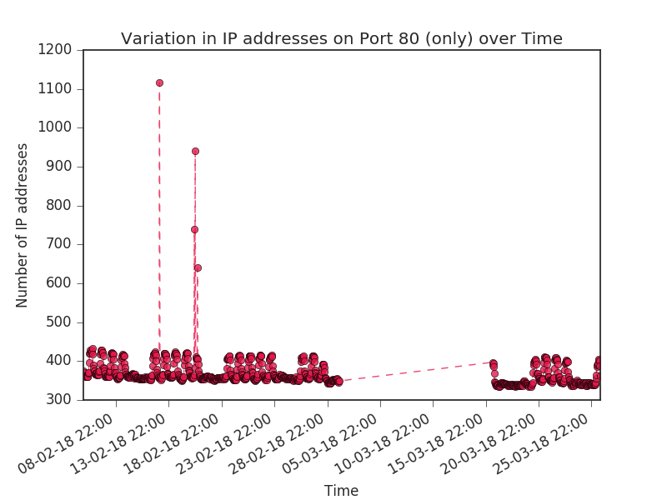

Slide 17
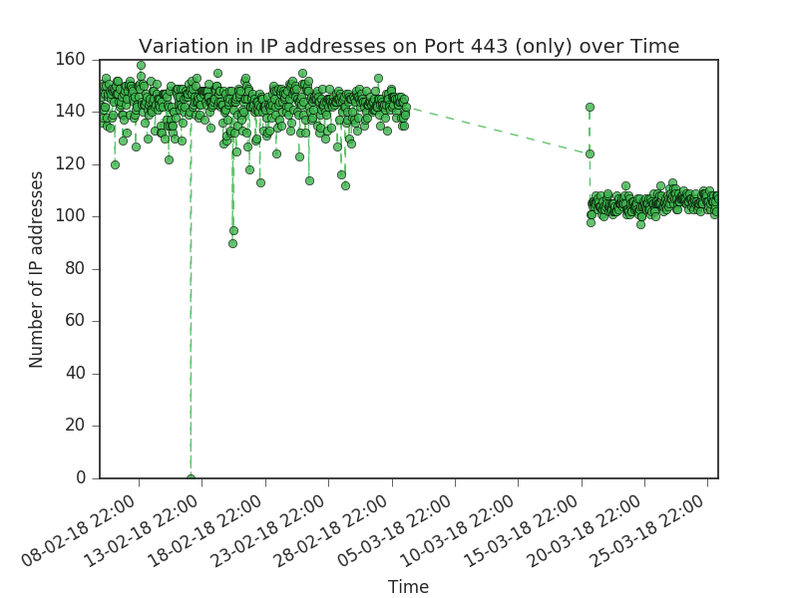

Slide 18
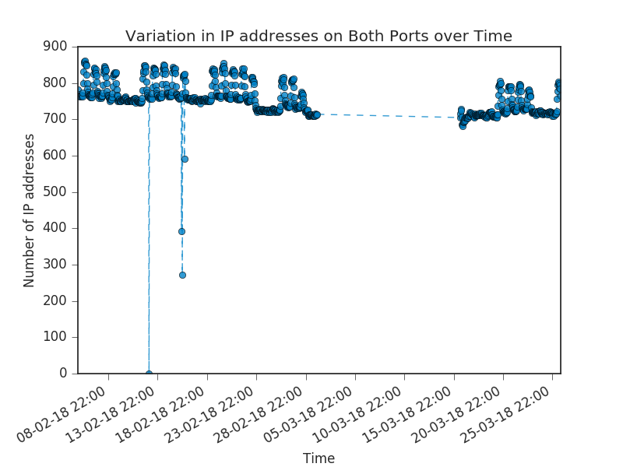

Slide 19
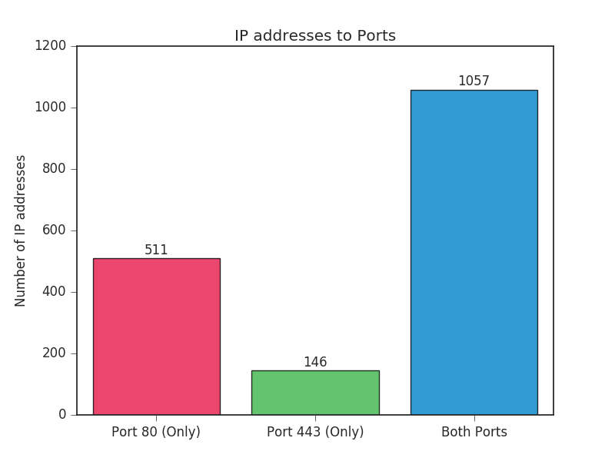

Slide 20
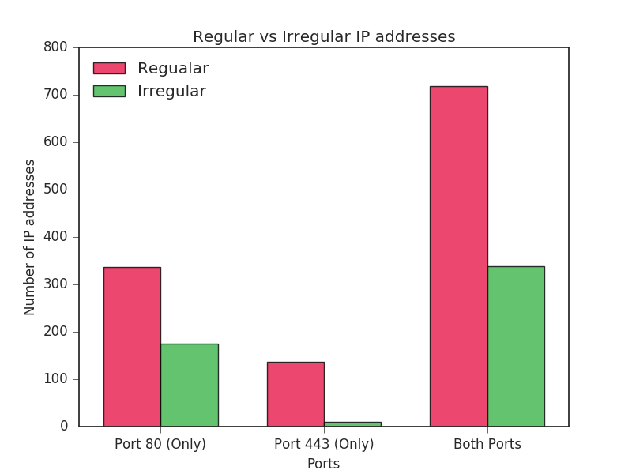

Slide 21
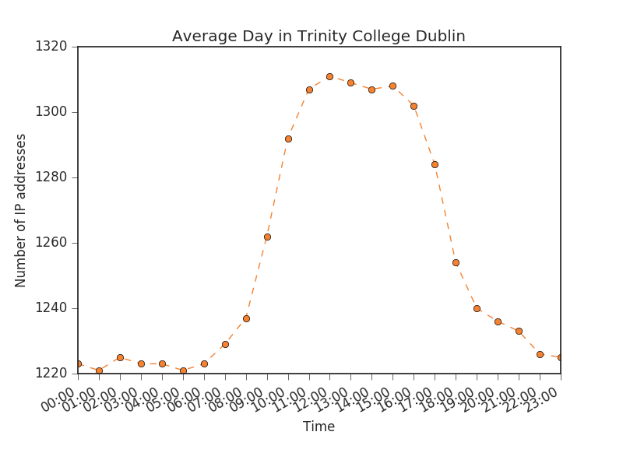

Slide 22
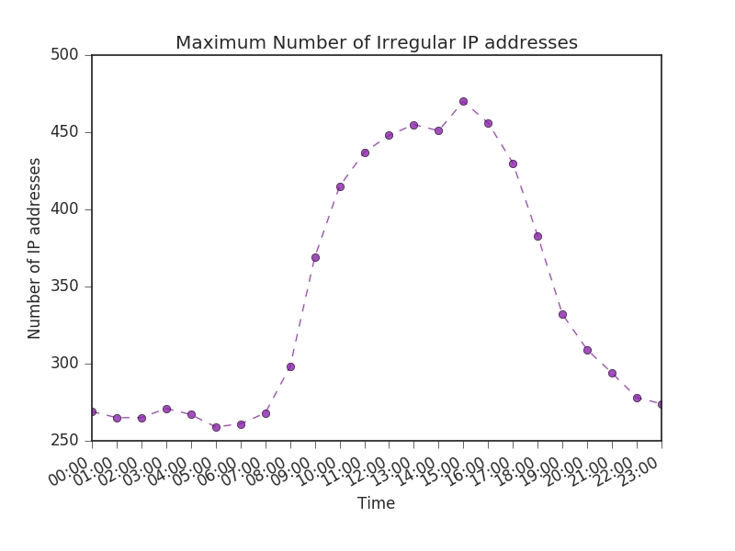

Slide 23
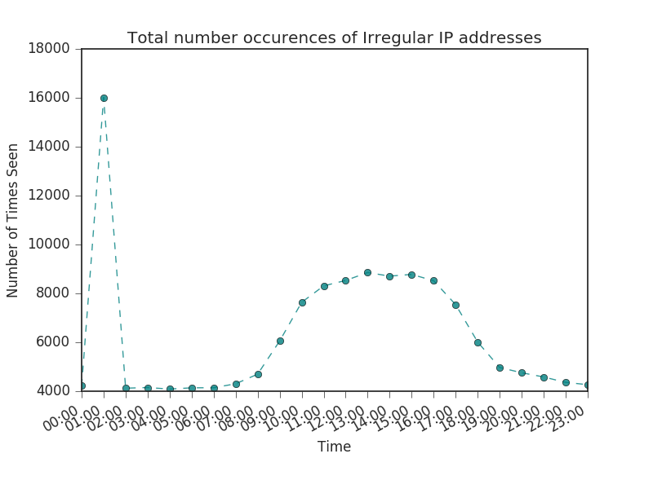

Slide 24
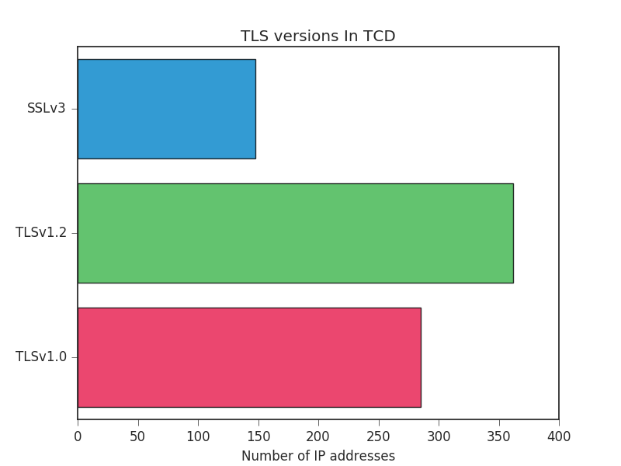
For TLS Graph

Slide 25

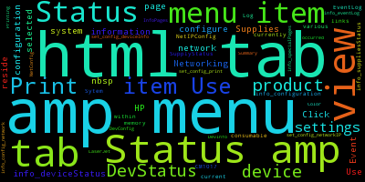
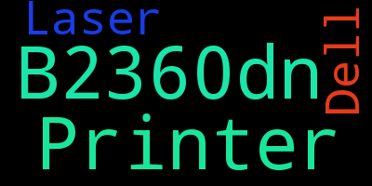

Slide 26

Conclusion

Slide 27

Questions?

